Slide 1

Stock Market Analysis

Slide 2
Agenda:
Introduction
Data Sources
DWH Model
Visualization and Dashboards

Slide 3
Team Crew:
Salma Samir
Salma Hasan
Ahmed Adel
Kareem Fouad

Slide 4
Introduction:
This project contains data from 500 companies in the stock market, and the objective of this project is to implement and identify a Data Warehouse model to support business intelligence queries and build an analytical framework that directly impacts the change of the stock market.

Slide 5
Data Sources:
Wikipedia List of S&P 500 companies:
https://en.wikipedia.org/wiki/List_of_S%26P_500_companies
S&P 500 Companies with Financial Information-Data Hub:
https://datahub.io/core/s-and-p-500-companies-financials#resource-constituents-financials
S&P 500 Stocks-Kaggle:
https://www.kaggle.com/andrewmvd/sp-500-stocks?select=sp500_stocks.csv

Slide 6
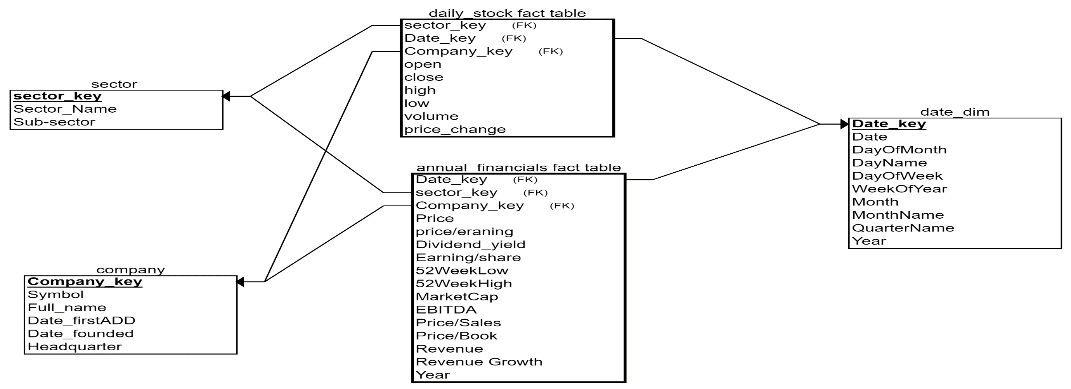
DWH Model:

Slide 7
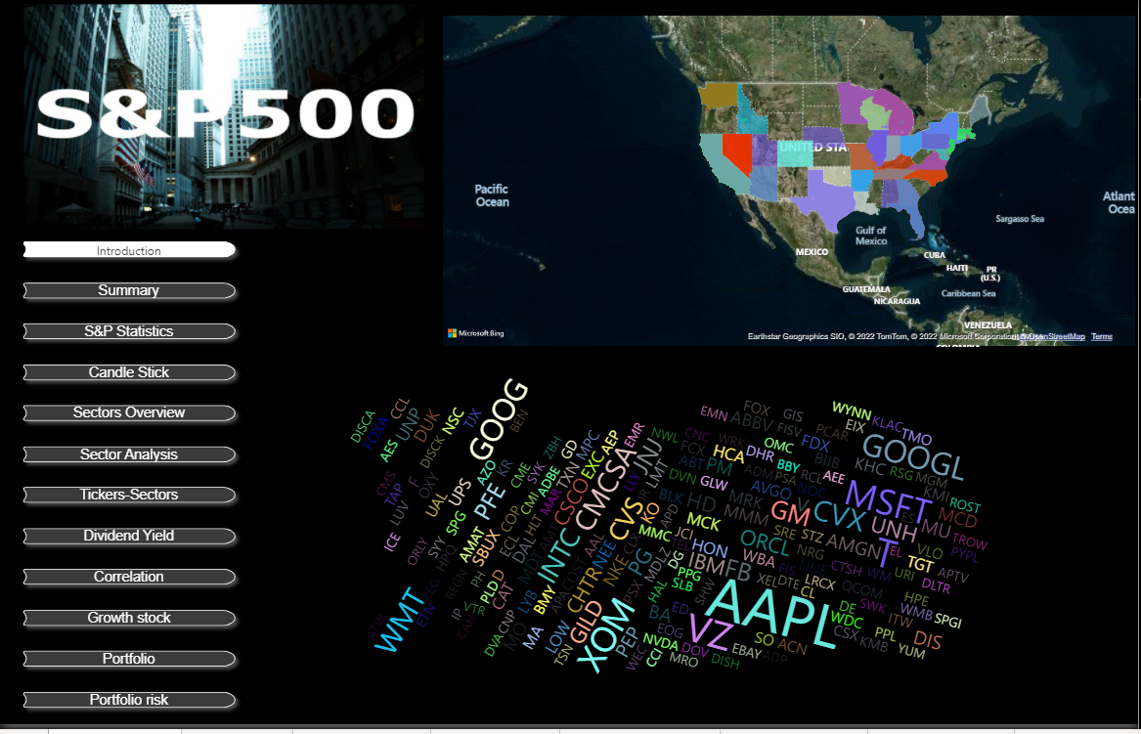
Visualization and Dashboards:

Slide 8
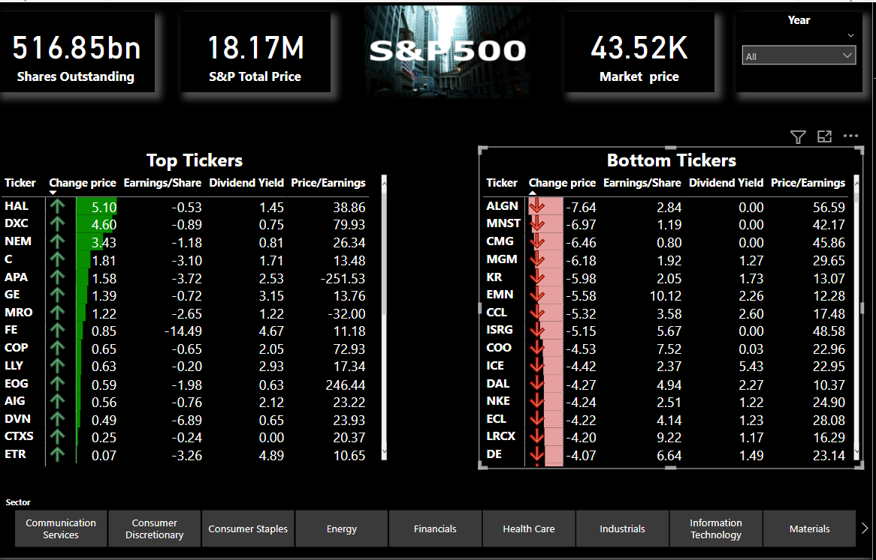

Slide 9
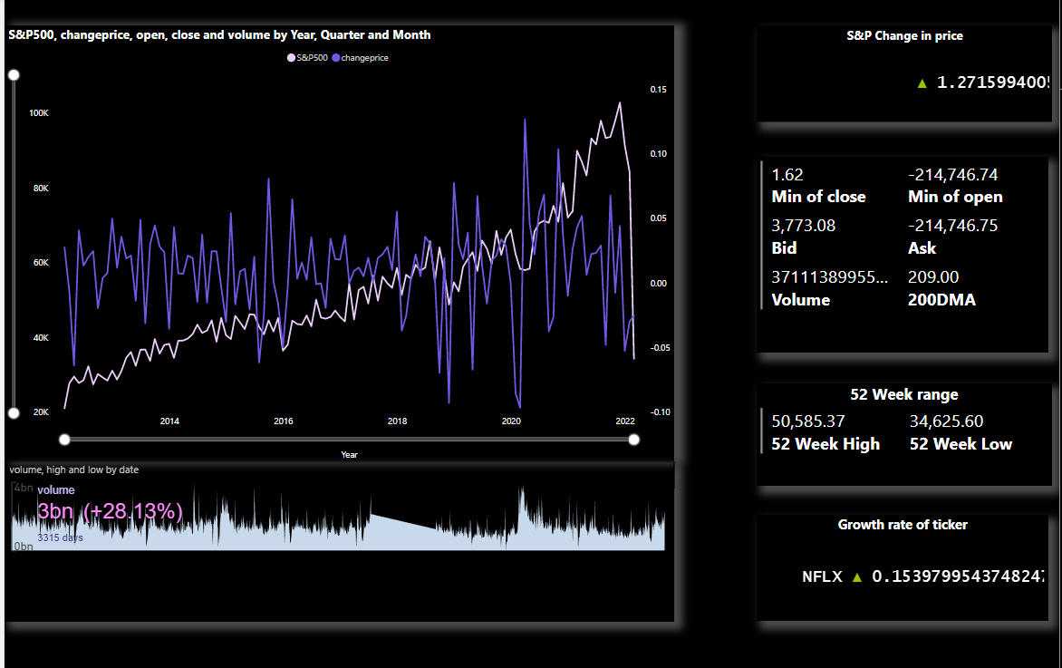

Slide 10
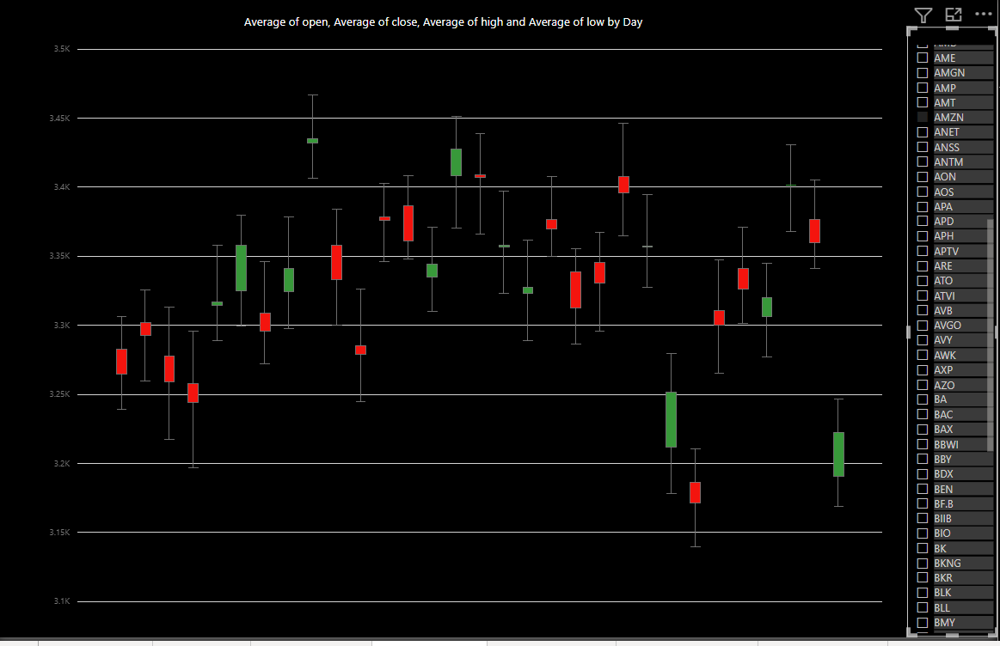

Slide 11
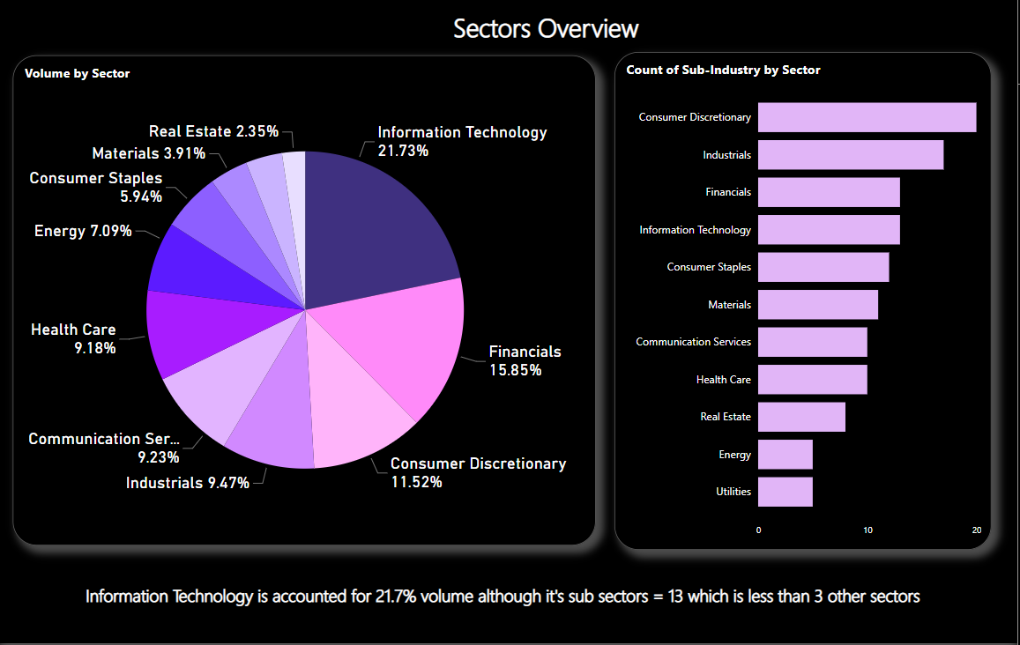

Slide 12
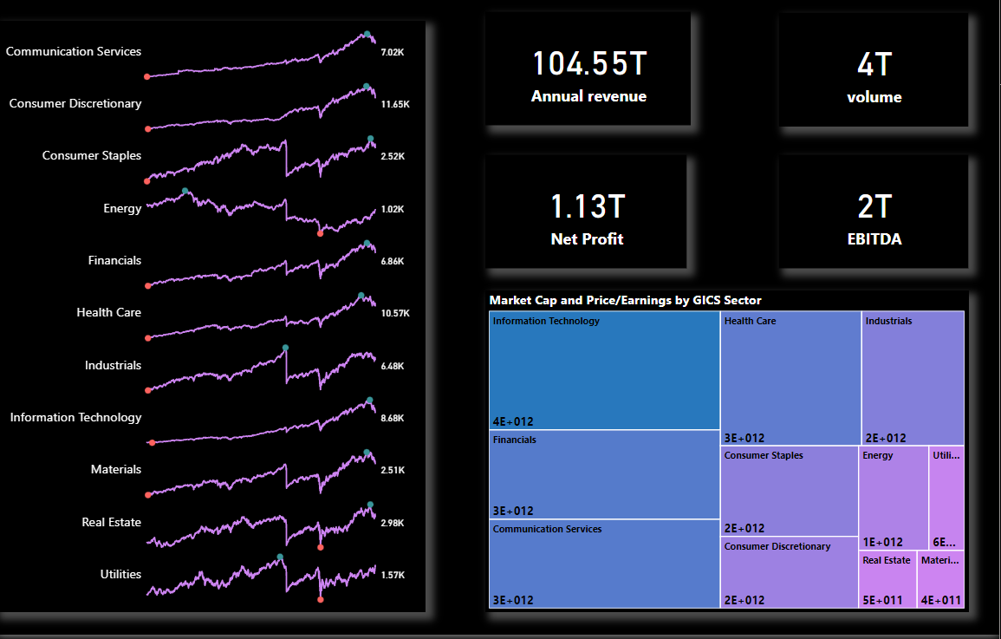

Slide 13
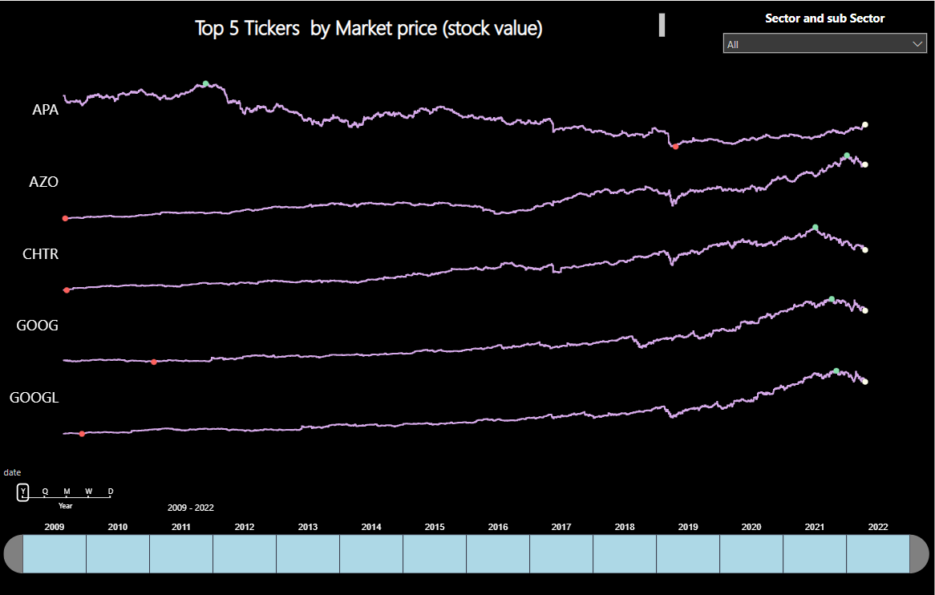

Slide 14
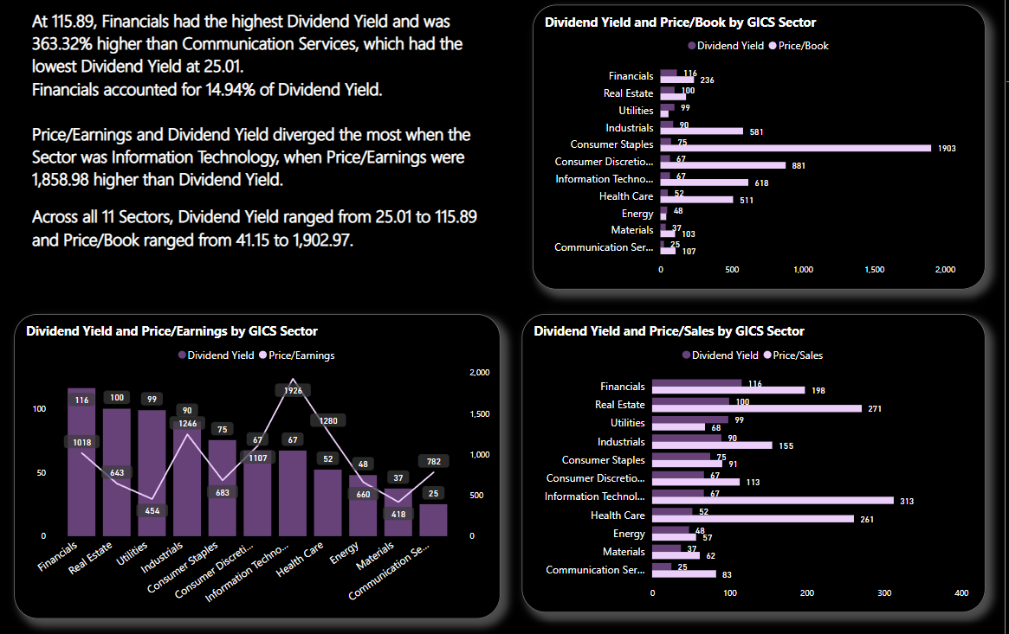

Slide 15
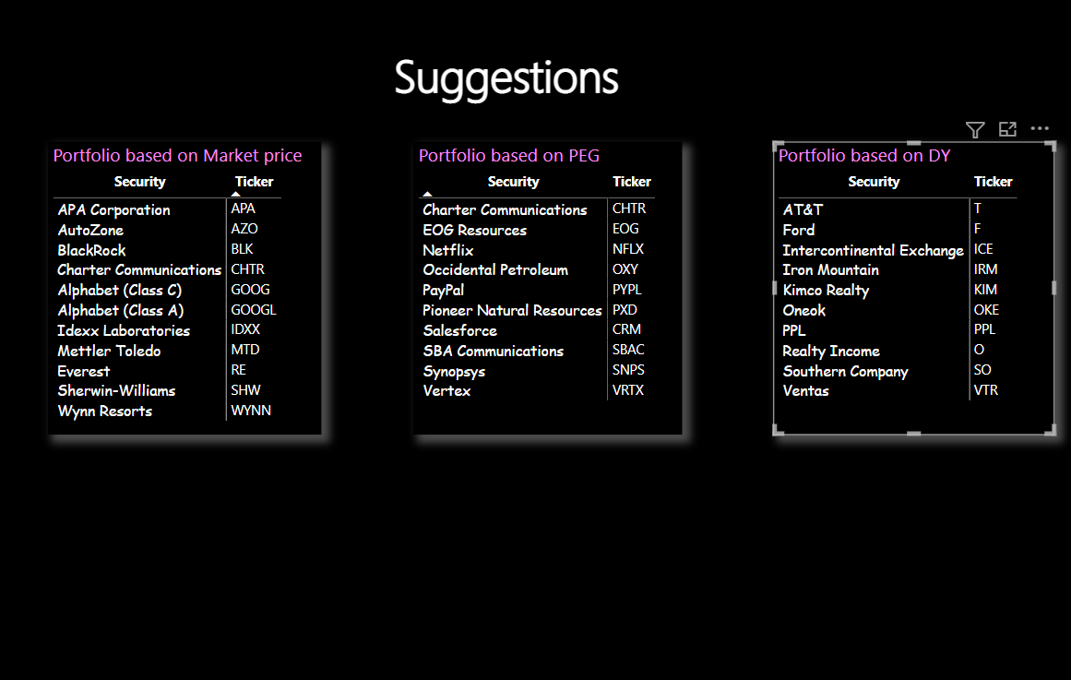

Slide 16
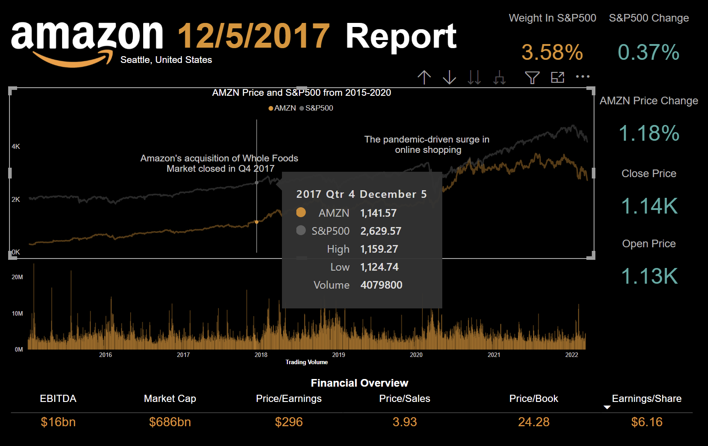

Slide 17
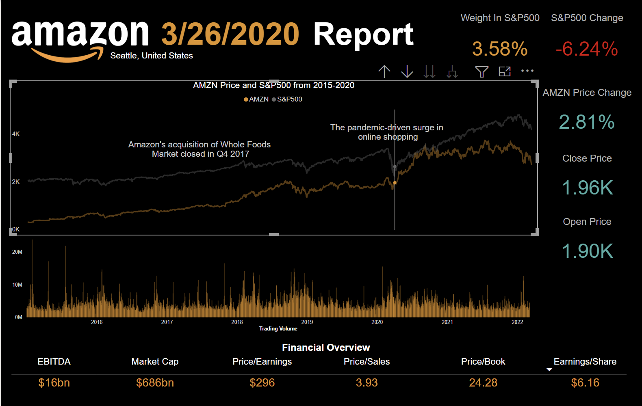

Slide 18
Thank You

